Slide 1
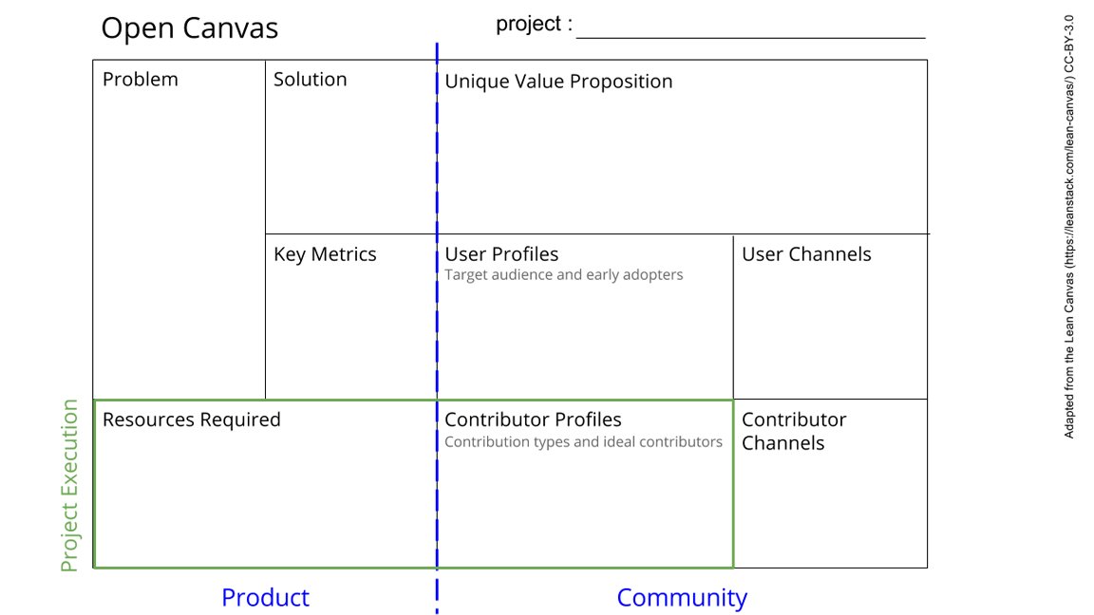
Training racialized scholars in the Faculty of Sciences on Digital Research Infrastructure (DRI) Utilization
Lack of awareness about DRI tools
Limited utilization of DRI tools
Train racialized scholars on the use of DRI tools
Start utilizing DRI tools
Knowledge level
Utilization of DRI level
Mailing list
This is a template. Please make a copy for yourself (file -> Make a copy).
See next slide for instructions!
Instructors
Researchers
Graduate students
Post-doctoral fellows
DRI capacity building and materials
Presentation equipment, including computer, projector, etc.
DRA
Supervisor
Dean
Email
Notes:
Go to File > Make a Copy… to make your own canvas
See next slide for instructions

